Slide 1
GOSHEN FIRE COMPANY
March 2025
MONTHLY OPERATIONS REPORT
FOR FIRE, EMS AND FIRE POLICE

Slide 2
SUMMARY
EMS calls are up 3% over last year, driven primarily by increases in East Goshen and Willistown. Fire calls are down 9% from last year, driven primarily by reductions in East Goshen, Willistown and mutual aid calls. Fire Police calls are down 17% from last year, driven by reductions in almost all townships.
Serious Incidents
Multiple Brush Fires | Throughout the district | 3/1
Multiple Electrical Fires | Primarily West Goshen Township | 3/1 – 3/2
Major Events
Easter Flower Sale | April 18-20 @ Station 56
Mother’s Day Flower Sale | May 9-11 @ Station 56

Slide 3
YEAR TO DATE SUMMARY
Staff-Hours on Calls | Fire | EMS
Volunteer | 135.03 | 126
Career | 36.6 | 1975

Slide 4
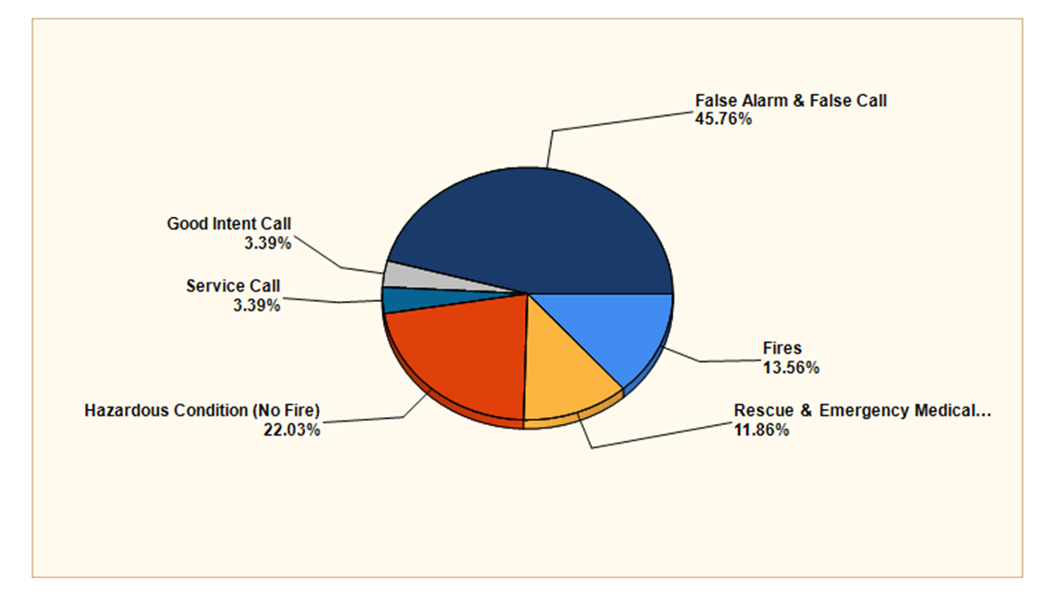
Fire Response Data
Calls by Township - Month
Fire Calls by Category - Month

Slide 5
Fire Response Data
Calls by Incident Type - month
INCIDENT TYPE | Count
140 - Natural vegetation fire, other | 1
141 - Forest, woods or wildland fire | 2
142 - Brush or brush-and-grass mixture fire | 2
143 - Grass fire | 3
311 - Medical assist, assist EMS crew | 1
322 - Motor vehicle accident with injuries | 3
324 - Motor vehicle accident with no injuries. | 1
352 - Extrication of victim(s) from vehicle | 2
412 - Gas leak (natural gas or LPG) | 3
440 - Electrical wiring/equipment problem, other | 2
444 - Power line down | 1
445 - Arcing, shorted electrical equipment | 6
462 - Aircraft standby | 1
531 - Smoke or odor removal | 1
551 - Assist police or other governmental agency | 1
600 - Good intent call, other | 1
622 - No incident found on arrival at dispatch address | 1
715 - Local alarm system, malicious false alarm | 1
730 - System malfunction, other | 1
735 - Alarm system sounded due to malfunction | 2
736 - CO detector activation due to malfunction | 2
740 - Unintentional transmission of alarm, other | 8
743 - Smoke detector activation, no fire - unintentional | 3
744 - Detector activation, no fire - unintentional | 1
745 - Alarm system activation, no fire - unintentional | 8
746 - Carbon monoxide detector activation, no CO | 1

Slide 6
Fire Response Data
Property Value and Loss Data
By Township - YTD
East Goshen Township
West Goshen Township
Westtown Township
Willistown Township

Slide 7
EMS Response Data
Total Calls | 414
Type Calls | #
FIRE-HOUSE | 1
FIRE-ODOR INVESTIGATION INSIDE | 3
FIRE-OTHER TYPE RESCUE | 2
FIRE-TRASH/DUMPSTER | 1
MEDICAL-ABDOMINAL PAIN - ALS | 7
MEDICAL-ABDOMINAL PAIN - BLS | 5
MEDICAL-ALLERGC/MED REACTION - ALS | 2
MEDICAL-ALLERGC/MED REACTION - BLS | 1
MEDICAL-ASSAULT W/ INJ (JO/IP) - ALS | 1
MEDICAL-BACK PAIN - ALS | 2
MEDICAL-BACK PAIN - BLS | 4
MEDICAL-BURNS - CHEMICAL - ALS | 3
MEDICAL-CARDIAC/RESP ARREST - ALS | 13
MEDICAL-CHOKING - ALS | 1
MEDICAL-CVA/STROKE - ALS | 14
MEDICAL-DIABETIC EMERGENCY - ALS | 3
MEDICAL-DOA - BLS | 7
MEDICAL-EMOTIONAL DISORDER - ALS | 3
MEDICAL-EMOTIONAL DISORDER - BLS | 16
MEDICAL-EXPOSURE TO HEAT/COLD - ALS | 1
MEDICAL-FALL / LIFT ASSIST - BLS | 107
MEDICAL-FALLS - ALS | 11
MEDICAL-HEART PROBLEMS - ALS | 24
MEDICAL-HEMORRHAGING - ALS | 10
MEDICAL-HEMORRHAGING - BLS | 3
MEDICAL-HYPO TENSION - ALS | 7
MEDICAL-INJURED PERSON - ALS | 1
MEDICAL-INJURED PERSON - BLS | 14
MEDICAL-OVERDOSE - ALS | 2
MEDICAL-OVERDOSE - BLS | 4
MEDICAL-RESPIRATORY DIFFICULTY - ALS | 43
MEDICAL-SEIZURES - ALS | 6
MEDICAL-SEIZURES - BLS | 4
MEDICAL-SICK PERSON - BLS | 33
MEDICAL-SYNCOPE - ALS | 2
MEDICAL-SYNCOPE - BLS | 2
MEDICAL-UNCONSCIOUS PERSON - ALS | 5
MEDICAL-UNRESPONSIVE PERSON - ALS | 4
By Municipality
East Goshen TWP | 197
West Goshen TWP | 125
Westtown TWP | 34
Willistown TWP | 42
Other | 16
Calls to Assisted Living and Retirement Communities
Arbor Terrace Willistown | 24
Bellingham | 17
Bryn Mawr Rehab
Harrison Hill Apartments | 7
Hershey’s Mill | 42
Merrill Gardens | 26
Park Lane | 22
Pembrooke | 23
Wellington | 32
Patients Treated
Patients Treated (Total) | 326
Patients Treated - Age 65 and Over | 245
 | 75%
Transport Destination | TOTAL
Bryn Mawr Hospital | 1
Childrens Hosp of Phila
Nemours Childrens Hospital
Paoli Memorial Hospital | 98
Penn Medicine – CCH | 155
Penn Medicine – Lancaster
Riddle Memorial Hospital
Total Patients transported | 254
Calls with no transport | 160
 | 39%

Slide 8
Fire Police Response Data
Total Calls | 31
Hours In Service | 21
Person Hours In Service | 124
Calls 2 Hours or longer | 2
Calls by Nature
Assist PD | 1
Brush | 6
Building | 1
CO Alarm | 2
Electrical Fire Inside | 2
Gas Leak | 2
Helicopter Landing Zone | 1
MVA | 11
Rescue | 1
Trash | 1
Trees & Wires | 3
RESPONSES BY MUNICIPALITY
East Goshen Township | 8
West Goshen Township | 12
Westtown Township | 8
Willistown Township | 3
Other | 0

